Slide 1


Medical Test at Home: GET CHECKED
Presented by:
Gautham Rajsimha Pulipati
Mrigesh Dasgupta
Akshay Bhosale

Slide 2

ECOSYSTEM
One place to buy any kind of medical test kit
Facilitate online and offline purchases
Standardized testing with doctor’s supervision
Consulting doctors for suggestions

Slide 3


Problem Statement
People are busy with work to wait at the hospitals for simple tests
Covid-19 pandemic makes it harder for people to go out
One application that solves this problem by delivering test kits home
Making the world a better place with healthier people

Slide 4
Solution
Application for the customer to order test kits online
Delivered quickly to home
Or the customer can buy it at a nearby store and mail it

Slide 5


Object Model Diagram

Slide 6
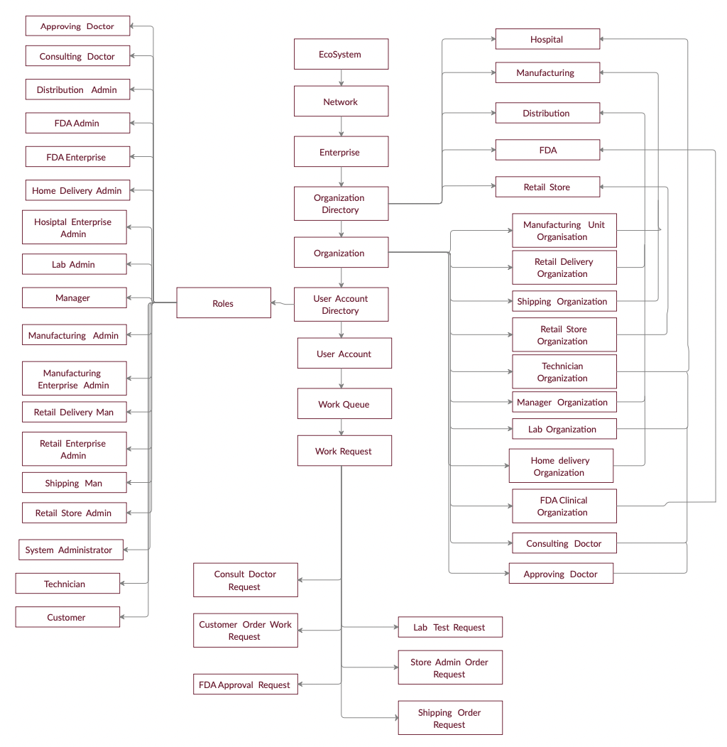

Slide 7

Sequence Diagram

Slide 8
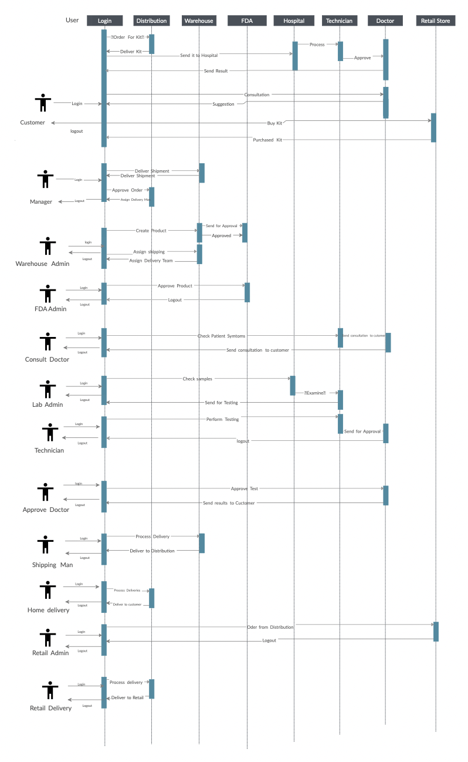

Slide 9
Conclusion
Application encourages people to get tested often
Anonymity is maintained between the customer and the doctor. This helps many people who do not want others to know about their condition
We can expand and keep adding more enterprises as we move on and the application facilitates all of it

Slide 10

Thank You

